Slide 1


RESEARCH AND STATISTICAL METHODS

Slide 2

Facilitator Details
Mrs Lee-Ann Inderpal
031-304 4626
Ms Suveera Singh
031 – 304 4626
N.B: Mr Stanton Thomas: researchadmin@regent.ac.za

Slide 3
What is Research?
Research can be referred to as a systematic way of answering questions about the world.
Aims:
  developing knowledge for processes of discovering new ideas or innovations;
  developing an understanding of the natural laws governing the universe;
  commitment to pursuing and achieving scientific excellence, and
  the pursuit of scientific and technological advantages which will improve the welfare of mankind.
All human beings regularly engage in some form of research.

Slide 4

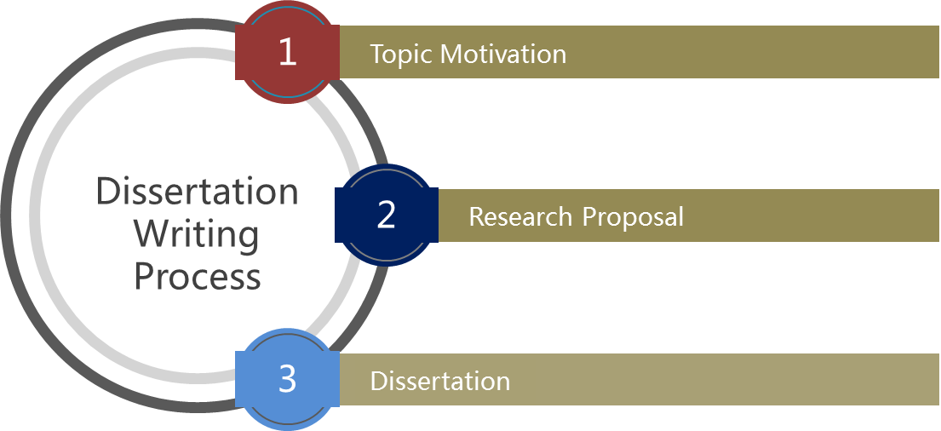
Dissertation Writing Process:

Slide 5
TOPIC MOTIVATION

Slide 6
1. Topic Motivation
Choose an area of interest, usually a problem area.
Consider the organisation that you work in.
Management/business perspective- MBA requirement (coursework)
Avoid ambiguous and broad topics (i.e. longitudinal studies)

Slide 7
Topic Motivation
Refrain from developing topics based on the premise of providing recommendations.
Choose a topic that investigates a problem, with proposed recommendations as an objective of the study.

Slide 8

  REQUIREMENTS FOR TOPIC SUBMISSION

Slide 9
Title of the Research/Topic
The topic needs to have a management or business perspective.
Generally, it should be an area that derives from your coursework (for example: job satisfaction, employee motivation, challenges facing profitability, etc).
Your topic needs to be concise and focused on a particular area or organization.
In order words, avoid topics that focus on broad setting such as “South Africa” for example. Rather, decide on a topic on a particular organization or group of organizations.
Topics should be worded concisely. Avoid lengthy and ambiguous topics.

Slide 10
Brief details/motivation for the topic
state why your topic is a viable
suitable topic,
and what contributions can it make to the organization/ institution under study

Slide 11
The Aim of the Study
This is a single broad statement which states what your study wishes to achieve.
For example: The aim of this study is to assess the factors affecting retention and recruitment of Nurses in a KwaZulu-Natal based hospital.

Slide 12
The Objectives of the Study
Objectives refer to specific sub-statements that will allow you to achieve your aim.
In other words, what objectives do you need to meet in order to be able to attain your aim.

Slide 13
The Objectives of the Study
Examples:
To identify the social factors affecting the retention and recruitment of nurses.
To identify the retention and recruitment strategies in place.
To assess the efficacy/ success of these strategies in retaining and recruiting nurses in…
To make recommendations to improve the retention and recruitment of nurses in…

Slide 14
The expected research outcomes (expected results of the proposed investigation)
you need to state the results that you expect from the study,
the potential benefit that these results will have in the organization/ institution.

Slide 15
Details of how data/information to carry the empirical research will be collected
There following areas need to be covered in this section:
Mention is this is a qualitative, quantitative or mixed method study.
Mention the data collection instrument that you will be using (i.e. interview schedule, face to face interviews, etc.)
Mention the setting of the study. For example, if you are using 3 organizations, mention them.
Mention who your target population is.
Mention the size of your target and sample populations

Slide 16
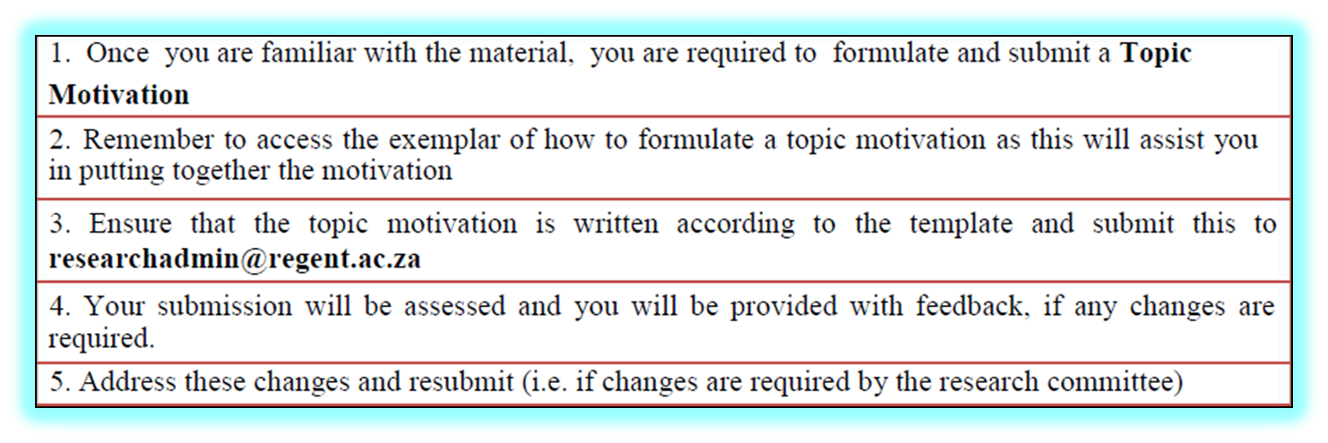

Slide 17
2. Research Proposal
Introduction
Background to the Problem
Aim Of the Research
Research Objectives
Research Questions
Research Problem/Hypothesis
Significance of the Research
Literature Review

Slide 18
2. Research Proposal
  Research Methodology
  Research Strategy (Quantitative/Qualitative)
  Target Population and Sample
  Sampling Strategy
  Data Collection Instruments
  Validity and Reliability
  Data Analysis

Slide 19
2. Research Proposal
  Pilot Study
  Limitations of the Research
  Elimination of Bias
  Ethical Consideration
  Format of the Research (Chapter Organisation)
  Proposed Timetable/ Timeline
  Bibliography

Slide 20
2. Research Proposal
Background to the Problem
  Sets the stage for problem that will be researched
  Facts about the problem
Aim Of the Research
  Formulate a clear and definite aim that sheds light on the whole topic.
  For example: The aim of this study is to investigate the impact of employee motivation on organisational performance.

Slide 21
Research Objectives
Research Questions
To identify the factors affecting employee motivation
To investigate the impact of employee motivation on organisational performance
To offer recommendations/strategies to improve employee motivation levels
What are the factors affecting employee motivation?
What is the impact of employee motivation on organisational performance?
What are the recommendations/strategies to improve employee motivation levels?

Slide 22
2. Research Proposal
Research Problem
  What is the actual problem?
  Provide an understanding of what research will be about
  Purpose, nature & reasons for study
  Context & circumstances

Slide 23
2. Research Proposal
Significance of the Research
  Why is the research worth undertaking?
  How will results of the study be used?
  Who will benefit?

Slide 24
2. Research Proposal
Literature Review
  Provides a conceptual framework,
  Structure according to research objectives
  Select most important and relevant theories, models and studies pertinent to your study.
  Sources: Use credible journal articles, papers, books
  Use current literature [not more than five years old]

Slide 25
2. Research Proposal
Literature Review
  Ensure a thorough mix of existing research articles and theory
  Do not dominate the review with a few references

Slide 26
2. Research Proposal
  Research Methodology
    Qualitative or Quantitative?
    Justification?
  Research Strategy
    Survey
    Case study
    Combined strategy
    Justification

Slide 27
  Target Population and Sample
    Relevance of target population to study
    Define target population
    Specify size of target population
    Specify size of sample
  Sampling Strategy
    Probability Vs Non-Probability
    Rationale for choice

Slide 28
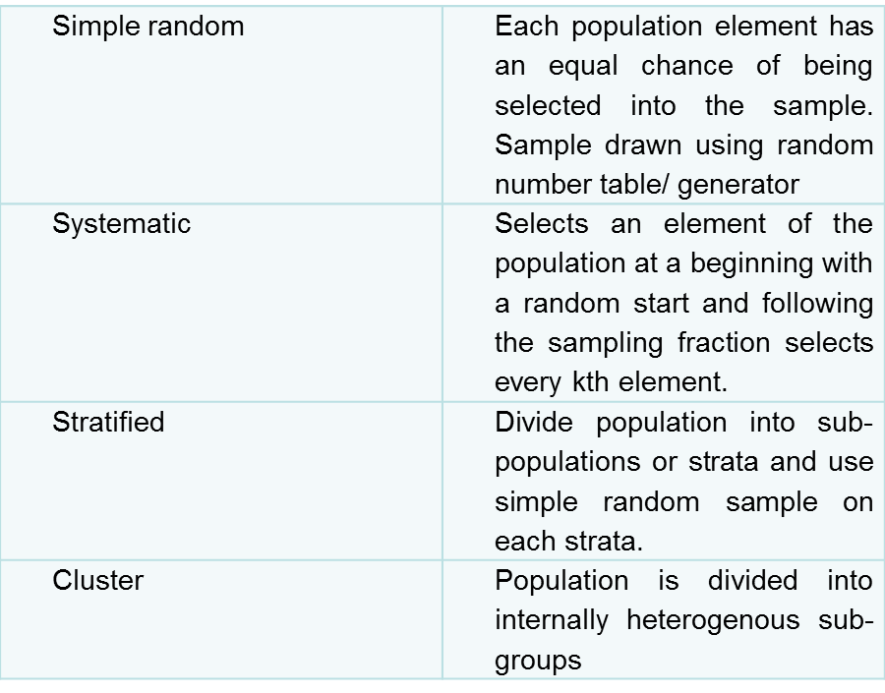
Probability Sampling

Slide 29
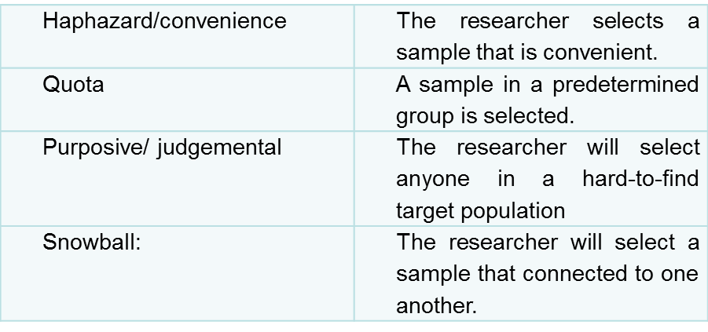
Non-Probability Sampling

Slide 30
  Data Collection
    Define
    Justification
    Questionnaires
    Interviews (Structured/Unstructured)
    Observations

Slide 31
  Validity
    Potential of a design or measuring instrument to measure what is supposed to achieve and or measure
    The researcher must cite the following types of validity and then explain how he applied them to his instrument:
    Content validity (representation of all elements?)
    Criterion- related validity (is the measure related to outcome?)
    Construct validity (measures its claim?)

Slide 32
  Reliability
    This pertains to the accuracy of measures.
    The same instrument must be able to produce the same data at a later stage under similar conditions.
    The researcher may do this by means of a test – retest (2 occasions)

Slide 33
  Data Analysis
    Qualitative or Quantitative?
    Rationale?
    Quantitative (Statistical techniques? Inferential: beyond description- judgements/conclusions can be inferred or explained; or descriptive statistics: describe basic features of data)
    Qualitative: Thematic analysis; Content Analysis; NVivo

Slide 34
  Pilot Study
    Pre-test
    Feasibility
    Possible flaws and improvements
    Relevance
    Amendments

Slide 35
  Limitations of the Research
    Shortcomings or restrictions
    E.g. Methods
  Elimination of Bias
  Use of gender neutral words
  Identifying people by race or ethnic group unless it is relevant
  Avoid language that suggests evaluation or reinforces stereotypes
  Making assumptions about various age groups

Slide 36
  Ethical Considerations
    Ensuring Participants have given Informed Consent
    Ensuring no Harm Comes to Participants
    Ensuring that Permission is Obtained
    Ensuring Confidentiality and Anonymity

Slide 37
  Format of the Research (Chapter Organisation)
  Proposed Timetable/ Timeline
  Bibliography

Slide 38
Please ensure that the following documents are included in your proposal before submission and that all headings above are adhered to:

Slide 39
Documents to be included:
  Ethical Clearance Form
  Permission Letter from the Company
  Draft Questionnaire (5 point Likert Scale)/Interview Schedule

Slide 40


Slide 41
Referencing
 | In-Text | Bibliography
Book | Smith (2015:58) claimed that … | Smith, D. (2015). Elements of Management. London: McMillan.
Electronic Journal | Johnson (2015) argued that democratic leaders welcome employee participation. Or Democratic leaders welcome employee particpation (Johnson, 2015). | Author, initials. (Year). Title. Journal title [online], volume (issue), location within host. Available at: URL [Accessed Date]. Johnson, M. (2015). Leadership in Africa. African Journal of Management [online] vol. 87(5). Available at: http://commerceinfo.com [Accessed 5 October 2015].

Slide 42
Referencing
 | In-Text | Bibliography
Internet: Web document | Lane (2013) claimed that … Or Technology is advancing at a rapid rate in the workplace (Lane, 2013). | Author. Year. Title. Place: Publisher (if available). Available at: web address of document [Accessed: day Month year]. Lane, C. (2013). The future of professionalised work: UK and Germany compared [Online]. London: Anglo-German Foundation for the Study of Industrial Society. Available at: http://www.agf.org.uk/pubs/pdfs/1232web.pdf [Accessed: 10 May 2014].
Internet Website | The population of SA is 55.6 million (Statistics SA, 2016). | Statistics South Africa. (2016). Community survey. Available at: http://cs2016.statssa.gov.za/ . [Accessed: 10 May 2016].
Government Publication | According to the Department of Health (2014), the number of nurses employed | Department of Health. (2014). Choice and opportunity: primary care: the future. CM 3390, London: Stationery Office. Available from URL [Accessed Date].

Slide 43
THANK YOU !

